Slide 1
GANs with conditional-generation

Slide 2
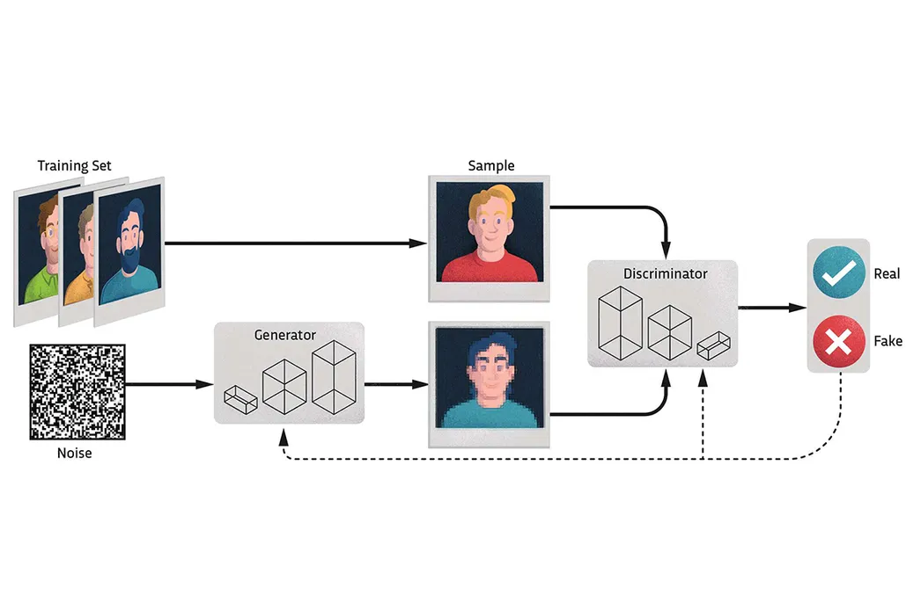
Base GAN
Notes:
A traditional GAN is fed a vector sampled from a Multivariate Normal Distribution (MND)
Eventually, one obtains a deterministic transformation that maps that MND onto the real distribution

Slide 3
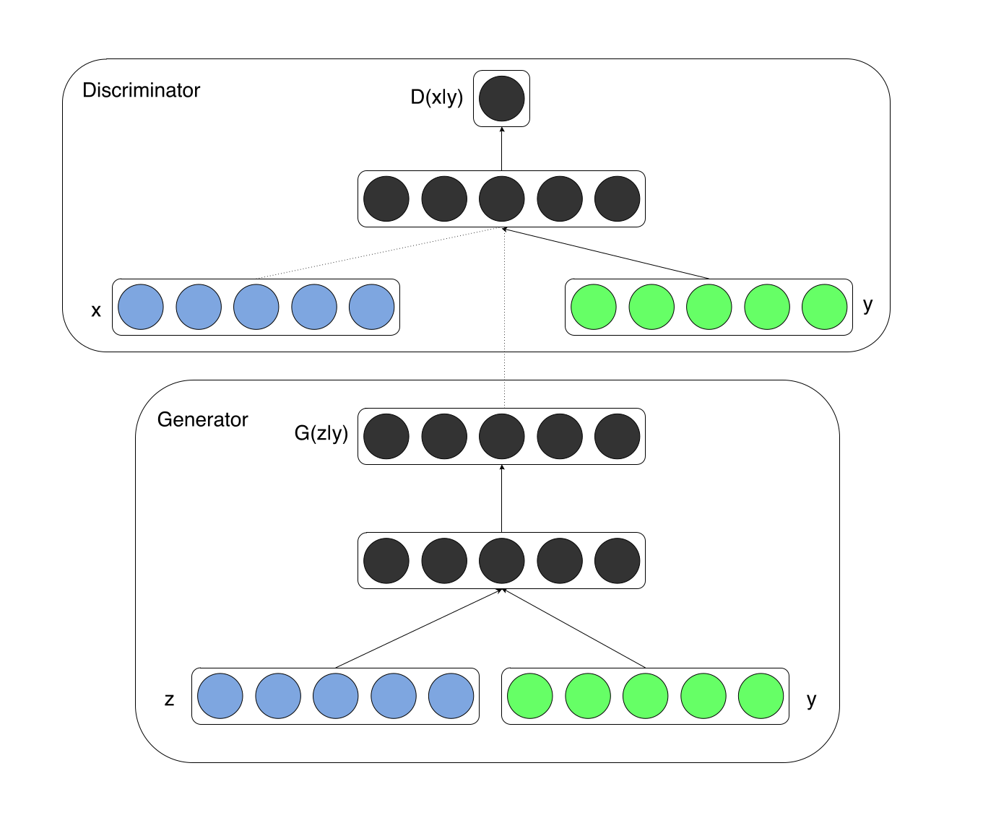
C-GAN

Slide 4
Synthetic Time-Series Load Data via Conditional Generative Adversarial Networks (2021)
Dataset:
Real phasor measurement unit (PMU) data from a U.S. utility (2017–2018).
12 load buses where transmission lines are fully monitored by PMUs.
Week-long profiles normalized per week and scaled between 0 and 1.
Uni-variate timeseries
Purpose:
To generate synthetic transmission-level load data via Conditional Generative Adversarial Networks (cGANs).
Customization by season and load type (e.g., residential vs. industrial).

Slide 5
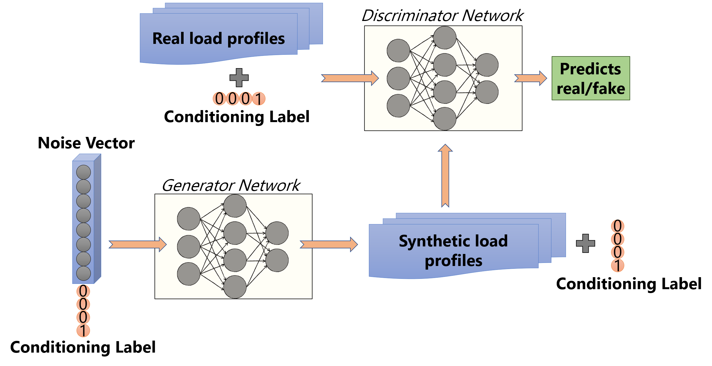
Synthetic Time-Series Load Data via Conditional Generative Adversarial Networks (2021)

Slide 6
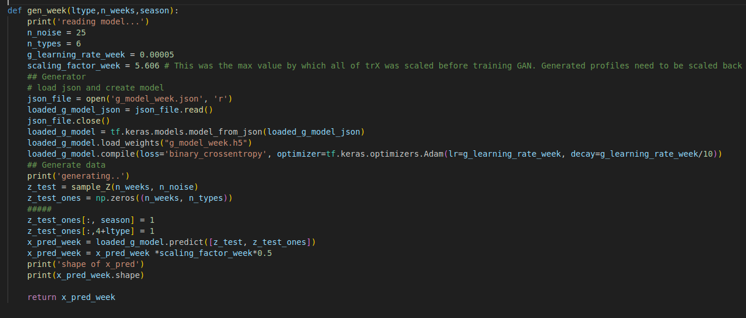
Synthetic Time-Series Load Data via Conditional Generative Adversarial Networks (2021)

Slide 7
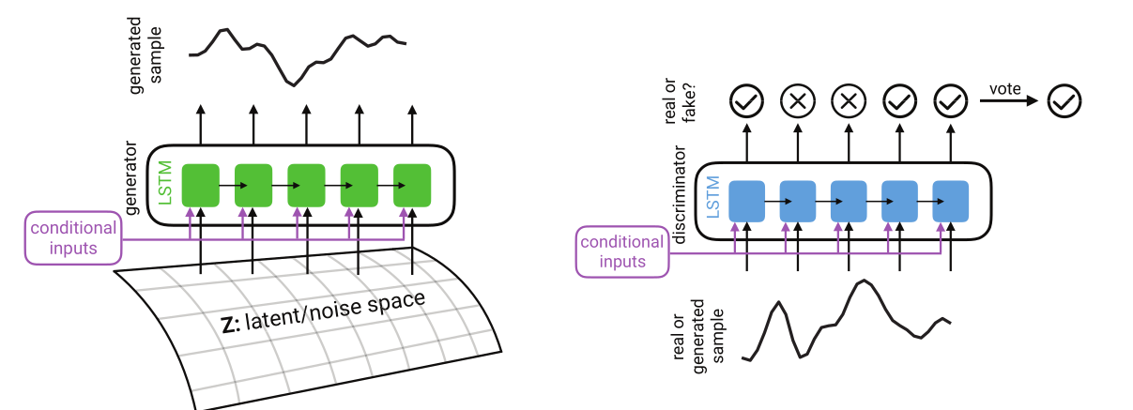
REAL - VALUED (MEDICAL) TIME SERIES GENERATION WITH RECURRENT CONDITIONAL GANS (2017)

Slide 8
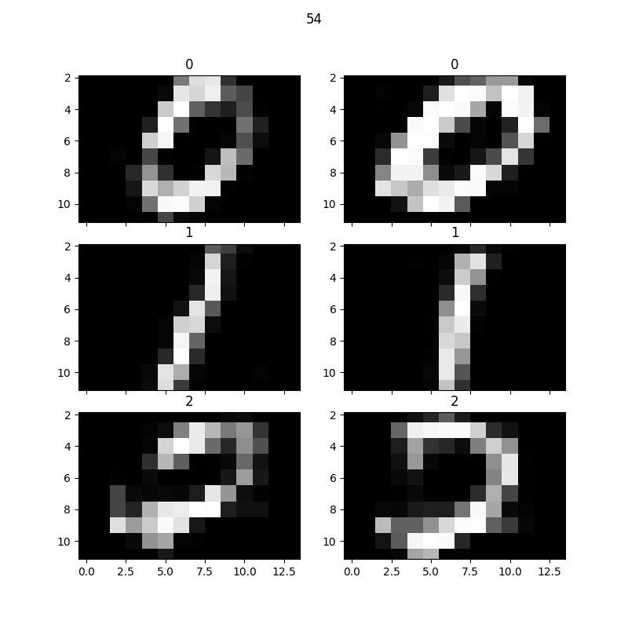
REAL - VALUED (MEDICAL) TIME SERIES GENERATION WITH RECURRENT CONDITIONAL GANS (2017)
Datasets
MNIST (as timeseries)
eICU (ICU patients)

Slide 9
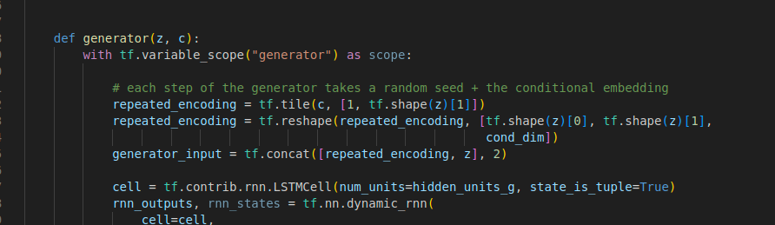
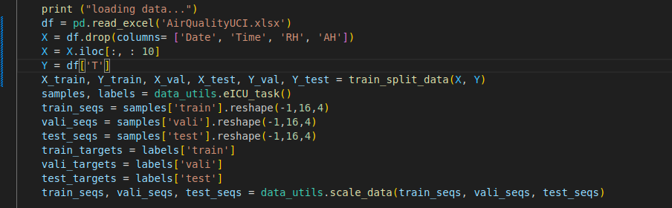
REAL - VALUED (MEDICAL) TIME SERIES GENERATION WITH RECURRENT CONDITIONAL GANS (2017)

Slide 10
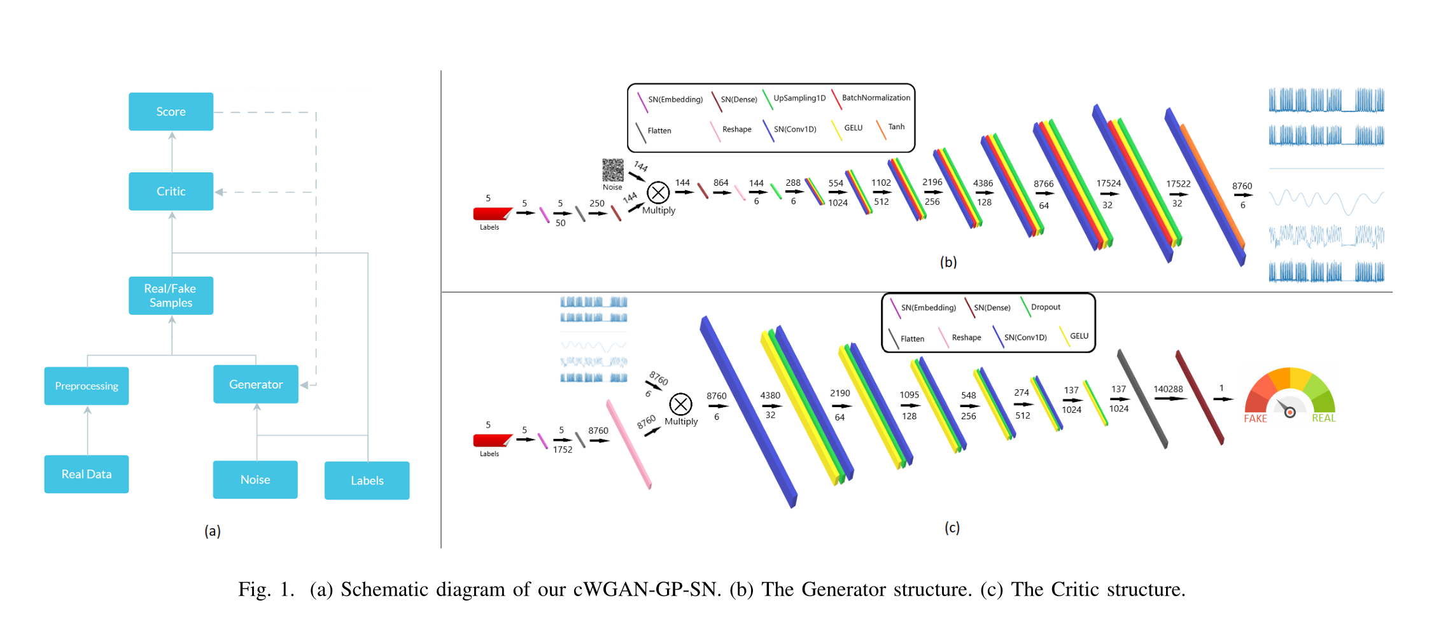
Conditional Wasserstein GAN for Energy Load Forecasting in Large Buildings (2022)

Slide 11
Conditional Wasserstein GAN for Energy Load Forecasting in Large Buildings (2022)
Data
Building Data Genome dataset (8760 measurements)
Multi-variate timeseries
For more features, they performed Auto-ARIMA and Real FFT.

